Slide 1






Lab 03
FIT5202 Big Data Processing

Slide 2
Session 03 Agenda
Session 02 Review
Join Strategies in Spark
Joins used in Spark
Understanding Query Execution Plan and DAG in Spark UI (Demo)

Slide 3
Session 02 Review
Understanding SparkSession and SparkContext
Data Partitioning in RDDs
Parallel Search and RDDs with multiple conditions
RDDs vs DataFrames
Partitioning in DataFrames
Searching and Filtering in DataFrames
Using SparkSQL With DataFrames.

Slide 4
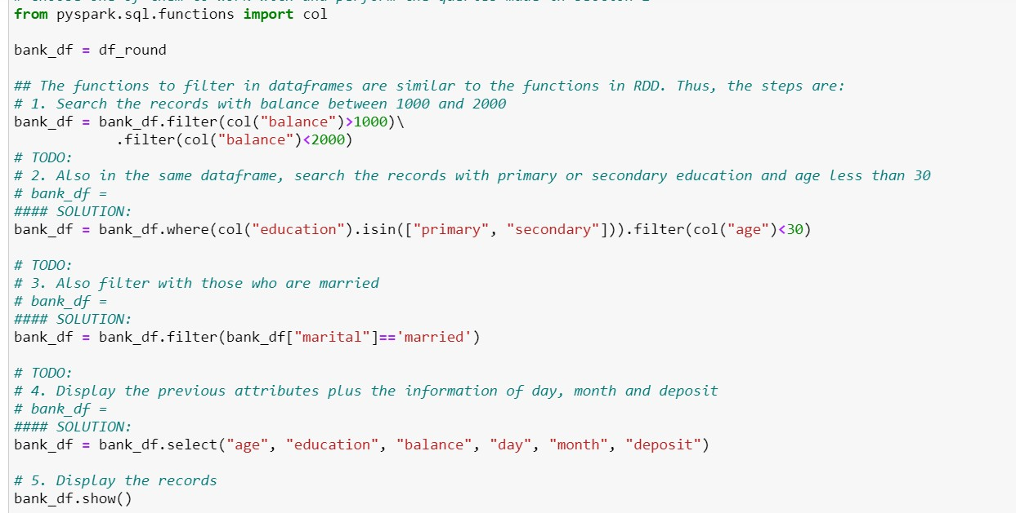
Solution – Session 02

Slide 5
Joining Strategies By Spark
Why do we need different join strategy?
Shuffle Sort Merge Join (default)
Broadcast Hash Join
Shuffle Hash Join
https://towardsdatascience.com/strategies-of-spark-join-c0e7b4572bcf

Slide 6
Review
Divide – equal
partitioning
Divide & Broadcast
No ‘ shuffling’
Broadcast
Stage 1: Data Partitioning
Hash partitioning
Disjoint data
partitioning
Parallel Join
Algorithms
Redistribution of data or ‘shuffling’
Range-based partitioning
Nested loop
Stage 2: Local Join (Serial algorithm)
Sort-Merge
Hash-based

Slide 7
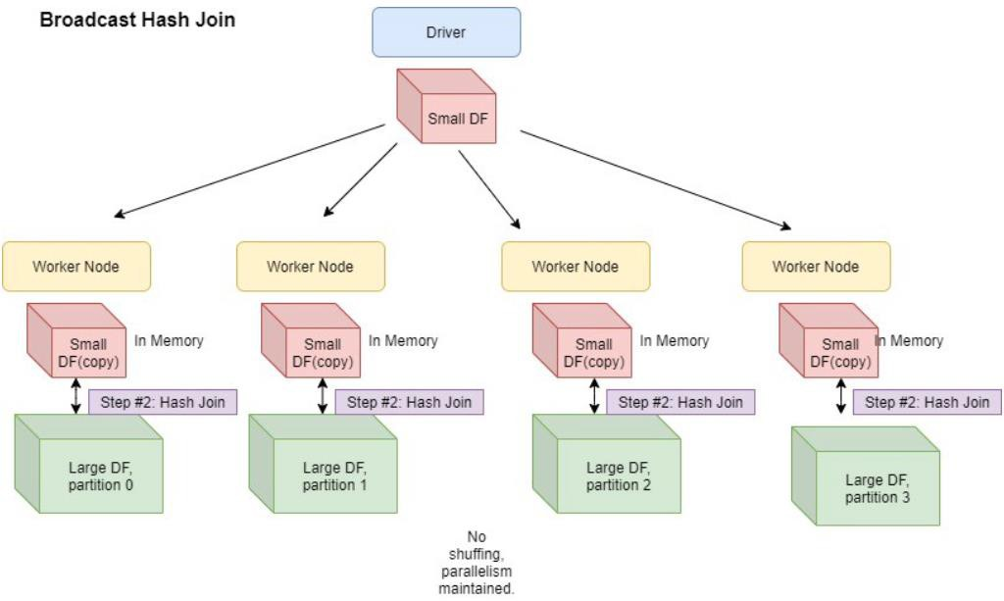
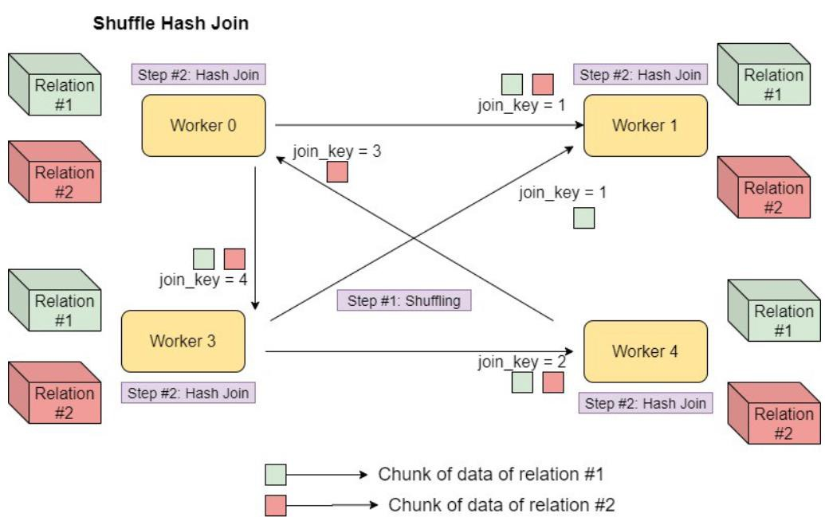
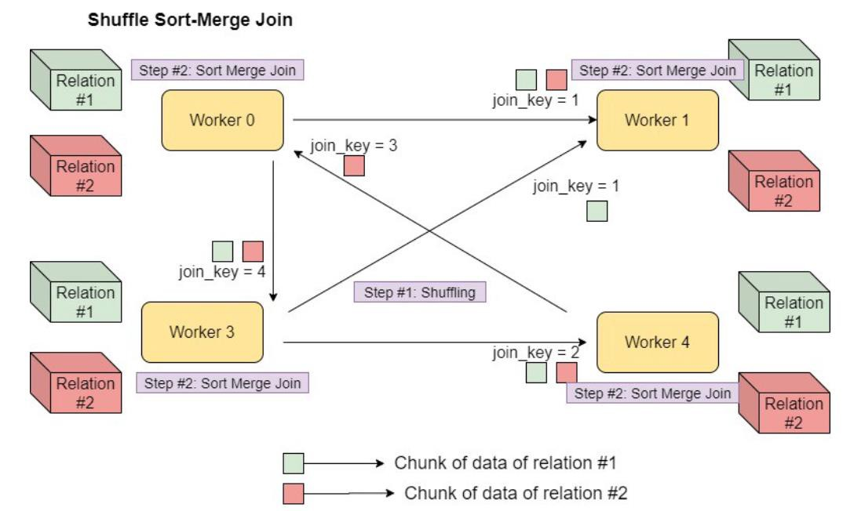

Slide 8
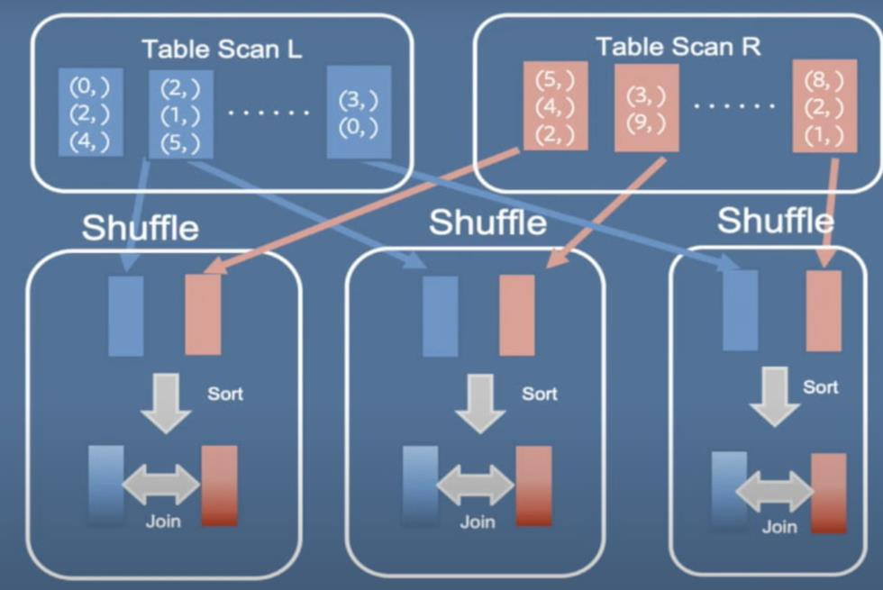
Join Strategies in Spark
Sort-Merge Join
Data from both tables are shuffled (when
no bucketing was done)
Data are then sorted based on the key and perform sort-merge join on each executor
Most Scalable joining strategy in Spark
https://databricks.com/session_eu19/spark-sql-bucketing-at-facebook

Slide 9
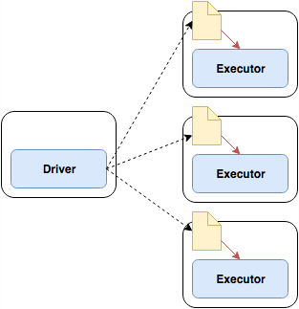
Join Strategies in Spark
Broadcast Hash
Smallest table is broadcasted to each node (using
broadcast variable)
Joining then takes place
Eliminates the shuffling process for bigger dataset.
Threshold can be Configured using “spark.sql.autoBroadcastJoinThreshold”
Default is 10 MB
https://henning.kropponline.de/2016/12/11/broadcast-join-with-spark/

Slide 10
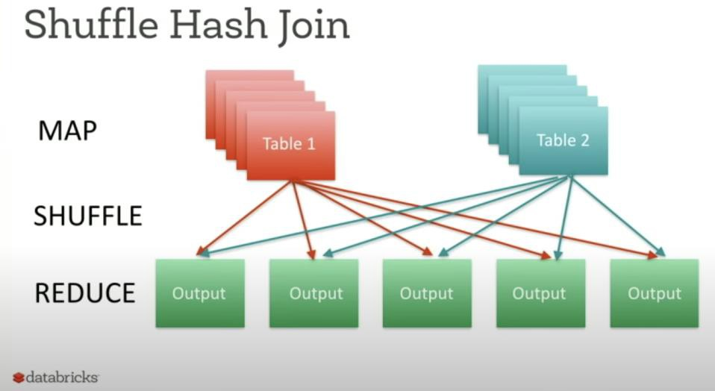

Join Strategies in Spark
Shuffle Hash
1. When both data frames are partitioned using same partitioner. So join keys will fall into the same partition.
https://databricks.com/session/optimizing-apache-spark-sql-joins

Slide 11
Join Strategies in Spark
When to use which?
When both datasets are too big : Sort-merge join/Shuffle-hash join
When one table is big and another is small : Broadcast Hash Join

Slide 12
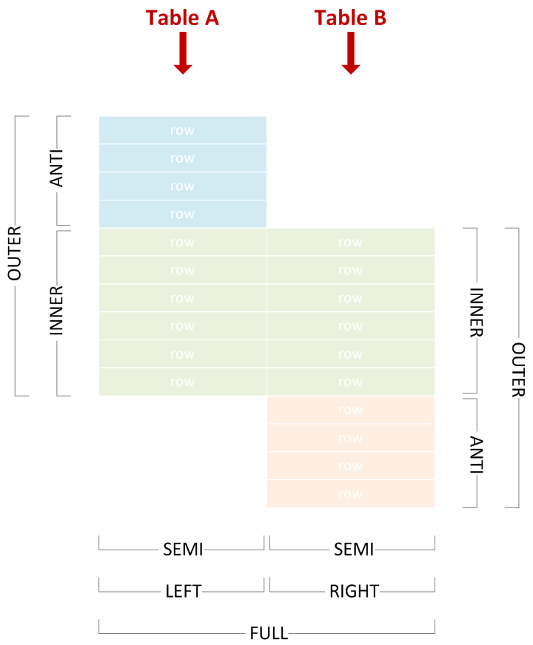
Other Core Joins
INNER
OUTER
LEFT
RIGHT
LEFT SEMI
LEFT ANTI

Slide 13
Query Execution Plan and DAG Demo
What is DAG? -> Directed acyclic graph - Wikipedia
Directed Acyclic Graph DAG in Apache Spark - DataFlair (data-flair.training)

